Slide 1
PROBLEMS ASSOCIATED WITH CLEAR TEXT PASSWORDS
Name – SAYANTAN DAS
Stream – CSE
Roll No. – 16800116036
Year – 4th
Semester – 8th

Slide 2
AUTHENTICATION
Authentication can be defined as determining an identity to the required level of assurance.
Authentication is the first step in any cryptographic solution
– Because unless we know who is communicating, there is no point in encryption what is being communicated.

Slide 3
AUTHENTICATION
Authentication is any process by which a system verifies the identity of a user who wishes to access it.
Authentication may be implemented using credentials, each of which is composed of a User ID and Password. Alternatively, authentication can be implemented with smart cards, an authentication server or even a public key infrastructure.

Slide 4
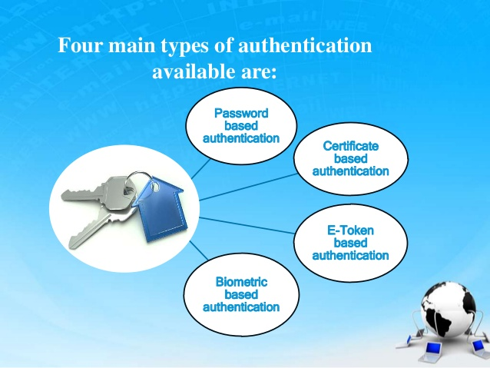

Slide 5
PASSWORDS
A password is a string of alphabets, numbers and special characters, which is supposed to be known only to the entity (usually person) that is being authenticated.
Password Based Authentication
- Clear Text Passwords
Simplest Password based Authentication Mechanism
How it works ?
- Prompt for user ID and Password.
- User enters user ID and Password.
- User ID and Password Validation
- Authentication Result
- Inform user accordingly

Slide 6
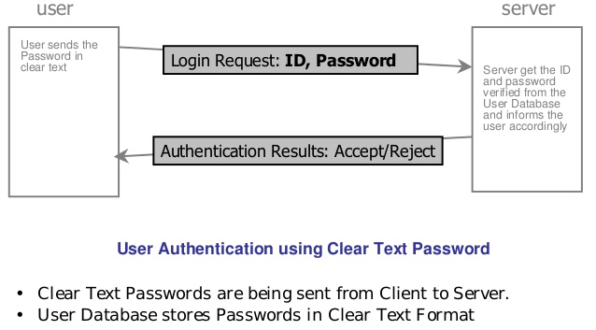
PASSWORD BASED AUTHENTICATION

Slide 7
PROBLEMS WITH CLEAR TEXT PASSWORDS
Database contains Passwords in clear text
It is advised that password should not be stored in clear text in databases.
Instead the passwords should be stored in encrypted form in database.
Password travel in clear text from user’s computer to the server
If the attacker breaks into the communication link, he can easily obtain the clear text password.

Slide 8
PROBLEMS WITH CLEAR TEXT PASSWORDS
Something Derived from Password
Message Digests of the Passwords
Storing Message Digests as derived passwords in the user database
User Authentication
- When a user need to be authenticated, the user enters the ID and Password.
- User’s computer computes the message digest of the password
- User’s computer sends the user ID and computed Message Digest to the server for authentication

Slide 9
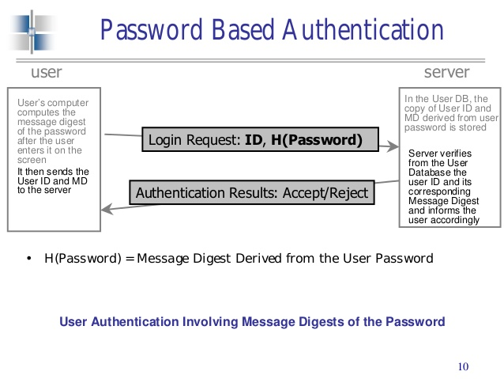
PROBLEMS WITH CLEAR TEXT PASSWORDS

Slide 10
PROBLEMS WITH THE MESSAGE DIGESTS OF THE PASSWORDS
– An Attacker cannot compute the original password back from the message digest of the password
– But he can simply copy the User ID and the corresponding Message Digest of the password, and submit them after some time to the same server as a part of the new login request.
– The server has no way of knowing that this login attempt is not from a legitimate user, but actually an attacker.
– This is called as REPLAY ATTACK, because the attacker simply replays the sequence of the actions of a normal user.
- Adding Randomness
> To improve the security & to detect a replay attack we need to add a bit of unpredictability or randomness to the earlier schemes. This will ensure that the replay attack is foiled.

Slide 11
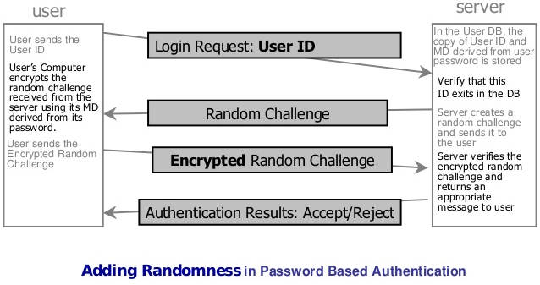
PROBLEMS WITH CLEAR TEXT PASSWORDS

Slide 12
BEST AUTHENTICATION SOLUTION
The best authentication solution may be considered as a combination of the password/PIN, a smart card and biometrics.
It covers all the three key aspects related to authentication
–Who you are,
–What you have,
–What you know
> However this can turn out to be an extremely complex system to build.

Slide 13
THANK YOU

